Slide 1
adjective comparative
Clara
2019-10-16

Slide 2
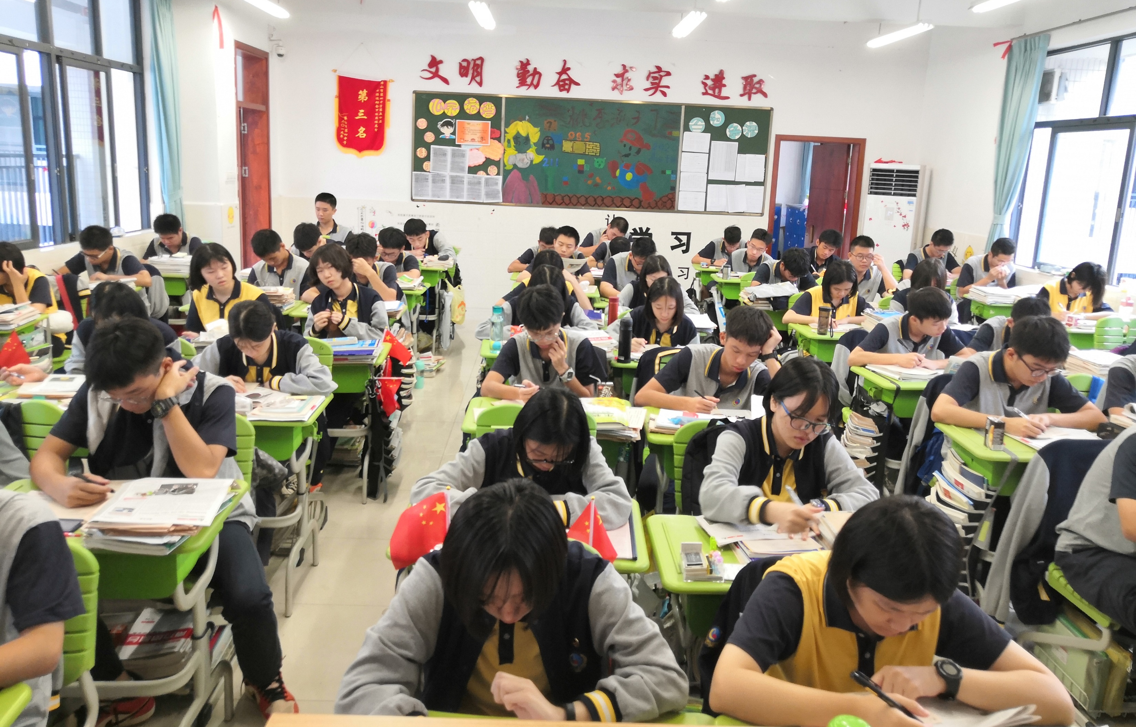
Describe your life in third grade.

Slide 3
Brainstorm: describe your life in third grade.
tired
stressful
Senior three life
exhausted
meaningful
hopeful
busy
……
What’s the function of adjective?
Voice opinion

Slide 4

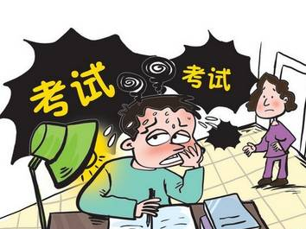
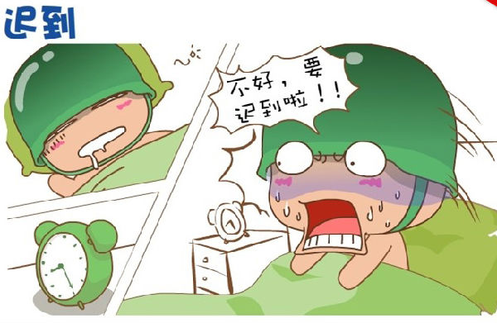
How to make your opinions convincing?
facts
too much homework
taking exam every week
getting up early
busy
stressful
tired

Slide 5
adj.
voice
opinion
support
facts

Slide 6
Task 1 Choose the best answer
facts
During my second year at the city college, I was told that the education department was offering a(n) ______ course, called Thinking Chess, for three credits. I jumped at the idea of taking the class because, after all, who doesn’t want to save a few dollars? More than that, I’d always wanted to learn chess. And even if I weren’t ______ enough about free credits, news about our competitor was appealing enough to me. He was an international grandmaster, which meant I would be learning from one of the game’s ______. (2018全国Ⅰ卷)
A. extra B. important C. meaningful D. free
A. excited B. worried C. moved D. tired
A. fastest B. easiest C. best D. rarest
1
2
3
opinions

Slide 7
Make a comparison
Read the two passages and tell the differences between the lifestyle of first graders and third graders.

Slide 8
What’s the difference between their life?
 | First grader | Third grader
vocabulary tested
arrival time in class
exam
morning reading
… | … | …
10 words
40 words
6:00
7:20
twice a semester
three times each week
20 minutes
40 minutes

Slide 9
Make a comparison
The words Monica required to memorize are four times the number of Jane.
Monica’s reading time is twice longer than Jane.
Exams Monica take are far more than Jane.
Monica gets to class one hour and twenty minutes earlier than Jane.
Jane takes more after-class activities than Monica.
challenging
demanding
stressful
tired
colorful

Slide 10
Voice your opinion
Which year do you like best in your high school life? Describe it with at least two adjectives and provide facts to prove it.

Slide 11
One possible version
I like my life in senior 3 best, because I think it is meaningful and hopeful. Although the assignment of the third graders is three times as much as that of the first graders, I grasp more knowledge and have a better understanding of what I have learned. As a third grader, I can only go home half of the first graders, which strengthen the relationship between my parents and me.

Slide 12
Conclusion
adj.
voice
opinion
support
facts
powerful!!!

Slide 13
Thank you!

Slide 14
What’s the function of adjective and adverb?
倍数的表达
句型 | 原级
At a rough estimate, the assignment of third graders is three times as much as that of first graders.
倍数+as…as…
At a rough estimate, the assignment of third graders is three times more than that of first graders.
倍数+比较级+than…
At a rough estimate, the assignment of third graders is three times more than the amount of that of first graders.
倍数+the+名词+of…
At a rough estimate, the assignment of third graders is three times as much as that of first graders.
倍数+that/those of…

Slide 15
Task 2 Cloze
1
….Those brown eyes were very ______. “What’s his name?” I asked the instructor. “Ben,” he replied, and immediately I knew. That stranger was my son!
The instructors called for an ambulance. ______, after a brief stay in hospital, Ben was well enough to be allowed to leave and later the family met up for dinner. (2018年全国Ⅱ卷)
A. sharp B. pleasant C. attractive D. familiar
A. Fortunately B. Frankly C. Sadly D. Suddenly
2

